Slide 1
Malignant Comment Classifier

Slide 2
PROBLEM STATEMENT:
The proliferation of social media enables people to express their opinions widely online. However, at the same time, this has resulted in the emergence of conflict and hate, making online environments uninviting for users. Although researchers have found that hate is a problem across multiple platforms, there is a lack of models for online hate detection. Online hate, described as abusive language, aggression, cyberbullying, hatefulness and many others has been identified as a major threat on online social media platforms. Social media platforms are the most prominent grounds for such toxic behaviour. There has been a remarkable increase in the cases of cyberbullying and trolls on various social media platforms. Many celebrities and influences are facing backlashes from people and have to come across hateful and offensive comments. This can take a toll on anyone and affect them mentally leading to depression, mental illness, self-hatred and suicidal thoughts. Internet comments are bastions of hatred and vitriol. While online anonymity has provided a new outlet for aggression and hate speech, machine learning can be used to fight it. The problem we sought to solve was the tagging of internet comments that are aggressive towards other users. This means that insults to third parties such as celebrities will be tagged as unoffensive, but “u are an idiot” is clearly offensive.Our goal is to build a prototype of online hate and abuse comment classifier which can used to classify hate and offensive comments so that it can be controlled and restricted from spreading hatred and cyberbullying.

Slide 3
Business Goal:
This project is more about exploration, feature engineering and classification that can be done on this data. Since the data set is huge and includes many categories of comments, we can do good amount of data exploration and derive some interesting features using the comments text column available.
You need to build a model that can differentiate between comments and its categories.
Refer to the data set file provided along with this.

Slide 4
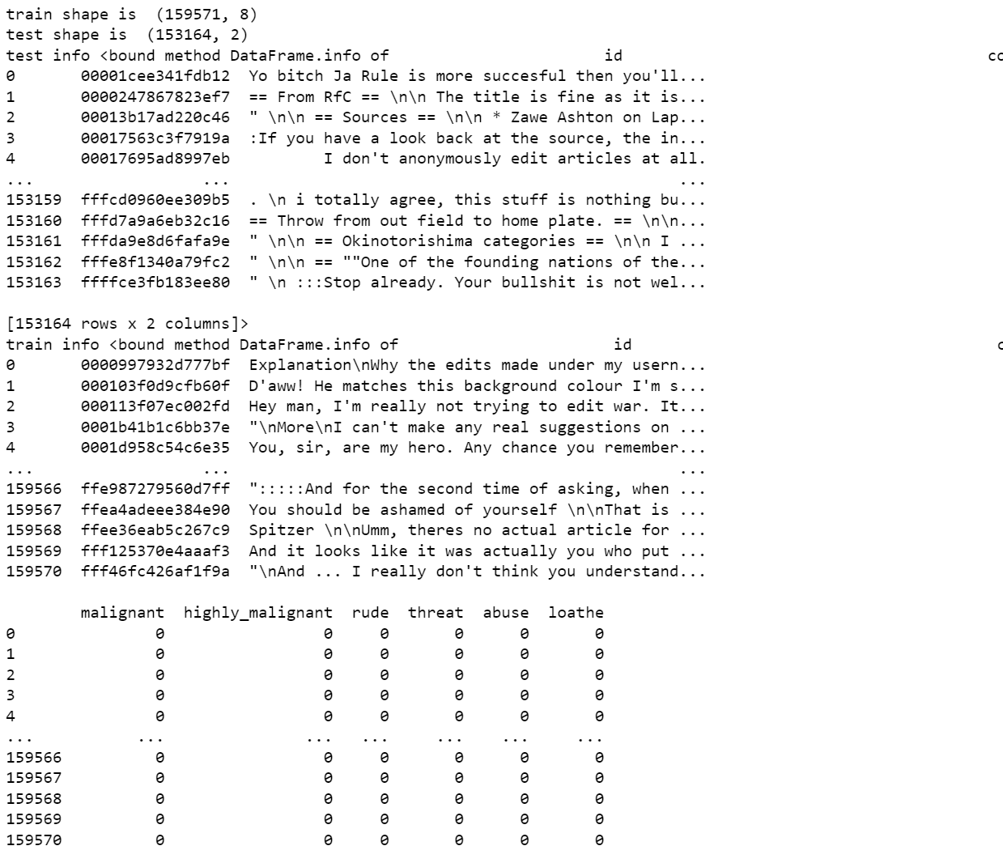
ABOUT THE DATASET:
Using various methods like shape,head,info(),describe to get some idea about the data we are handling

Slide 5
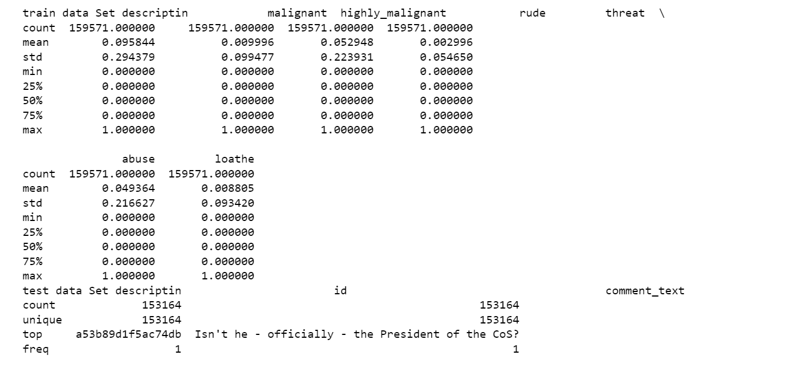
ABOUT THE DATASET:

Slide 6
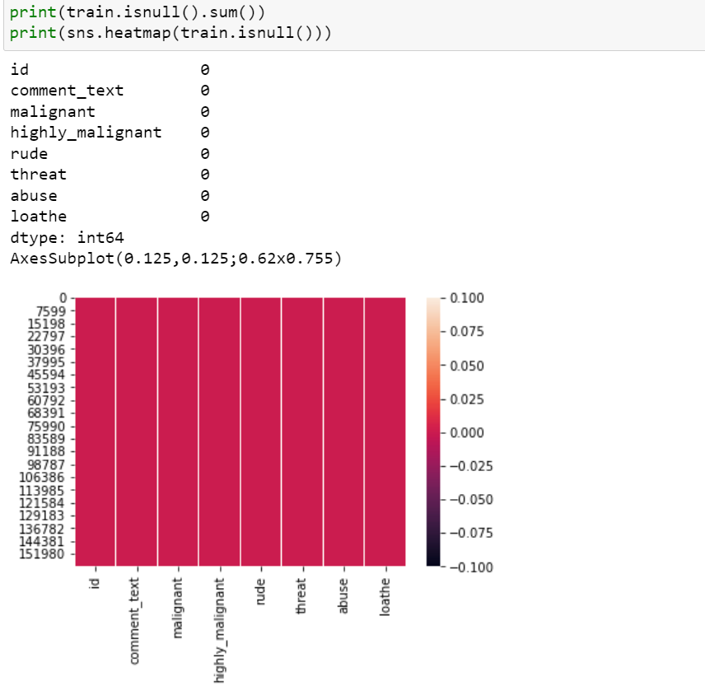
NULL VALUE CHECK:
Checking null values present in data by heatmap

Slide 7
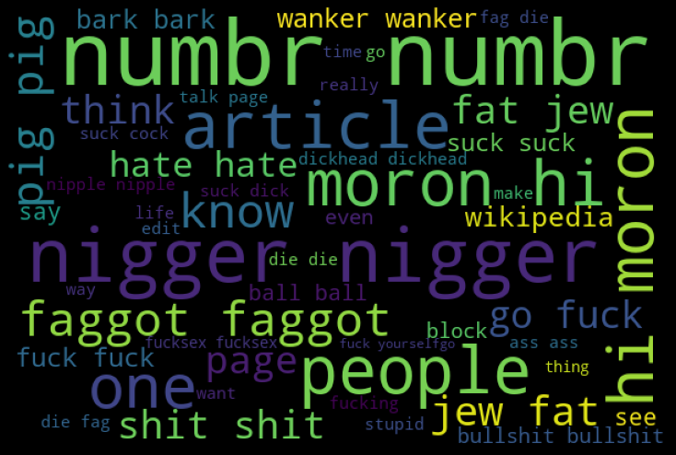
VISUALIZATIONS :
Observation:
Based on the Word Cloud plot these are words which is most often repeated in malignant comments.

Slide 8
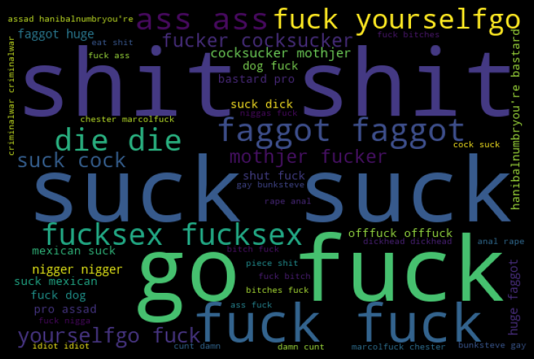
VISUALIZATIONS :
Observation:
Based on the Word Cloud plot these are words which is most often repeated in Highly Malignant comments.

Slide 9
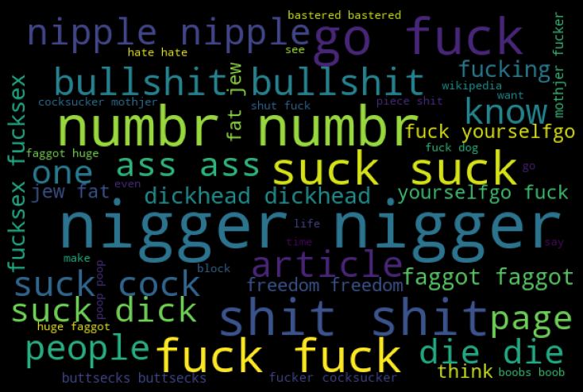
VISUALIZATIONS :
Observation:
Based on the Word Cloud plot these are words which is most often repeated in Rude comments.

Slide 10
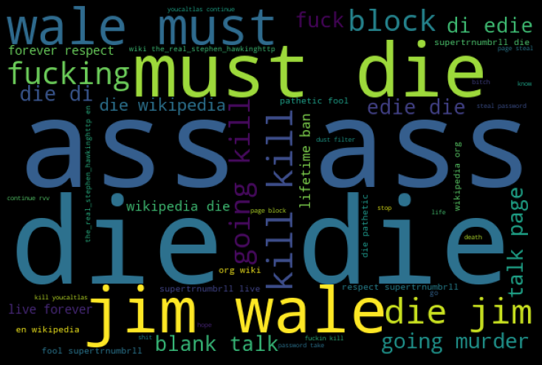
VISUALIZATIONS :
Observation:
Based on the Word Cloud plot these are words which is most often repeated in threat comments.

Slide 11
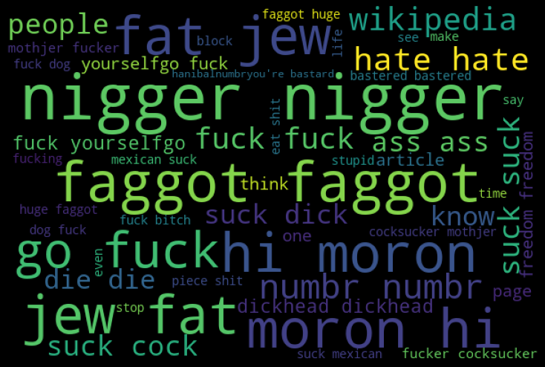
VISUALIZATIONS :
Observation:
Based on the Word Cloud plot these are words which is most often repeated in abuse comments.

Slide 12
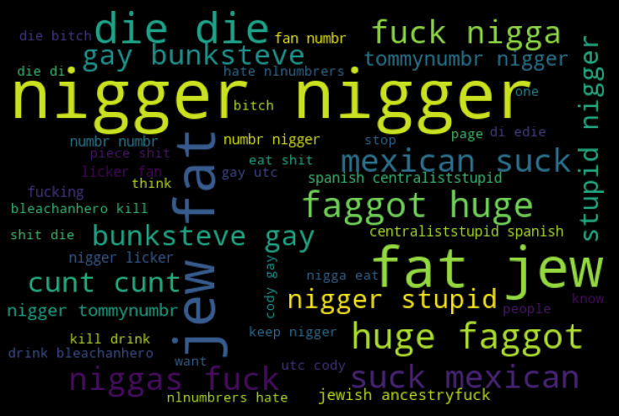
VISUALIZATIONS :
Observation:
Based on the Word Cloud plot these are words which is most often repeated in loathe comments.

Slide 13
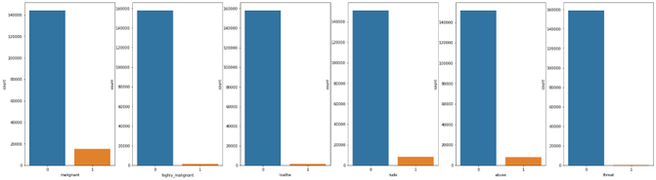
VISUALIZATIONS :
Observations:
Malignant Comments are higher compared to others

Slide 14
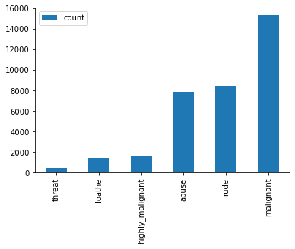
VISUALIZATIONS :
Observation:
Type of Classification Comments plotted. We can malignant comments are higher.

Slide 15
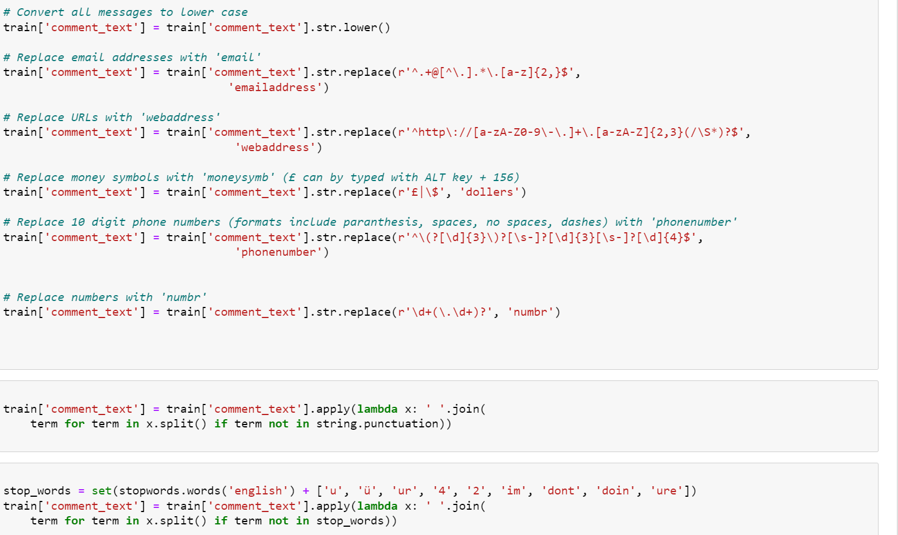
Data Pre-processing

Slide 16
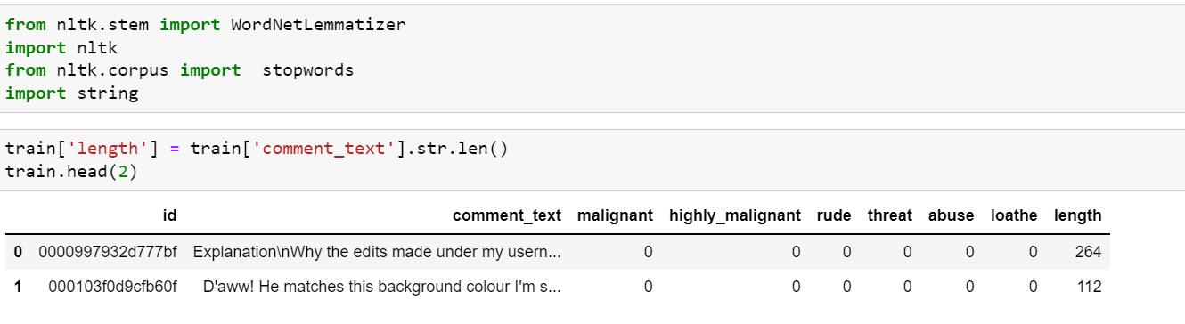
Data Pre-processing

Slide 17
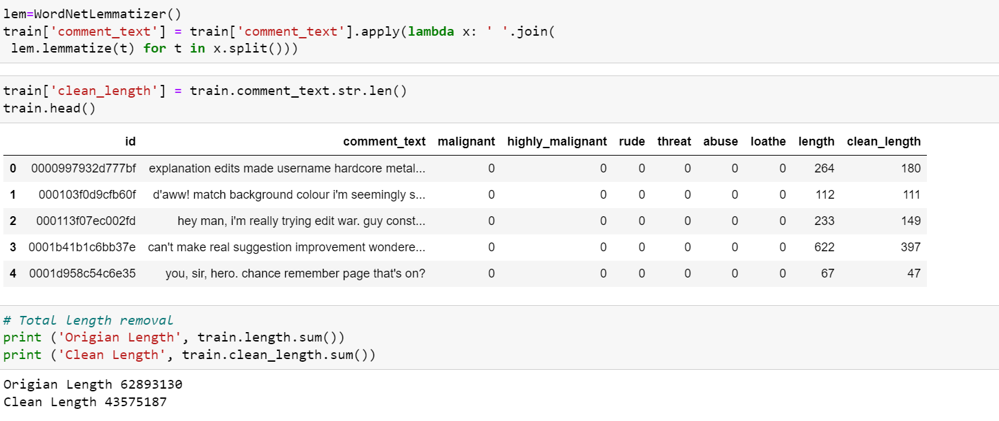
Data Pre-processing

Slide 18
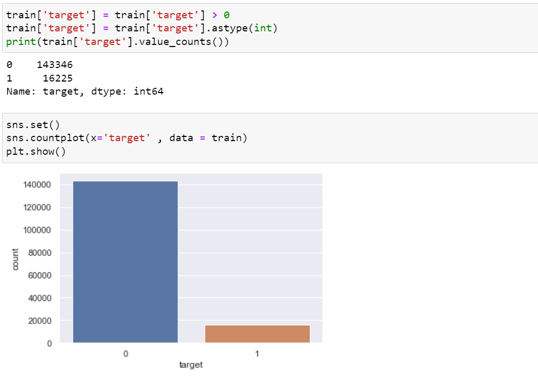
Data Pre-processing

Slide 19
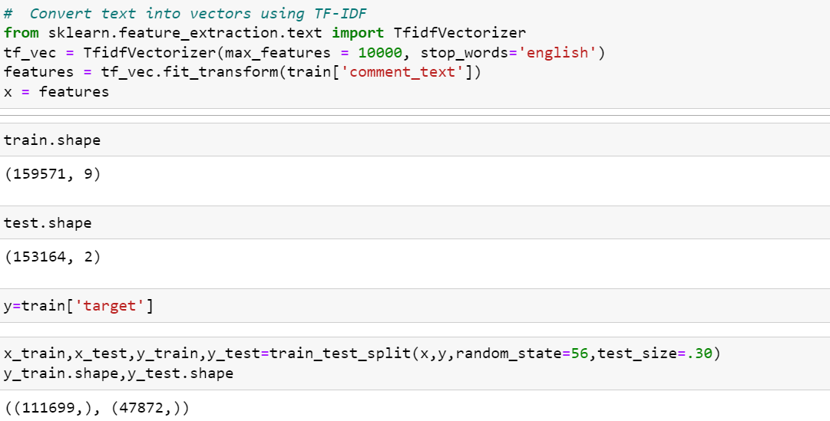
Data Pre-processing

Slide 20
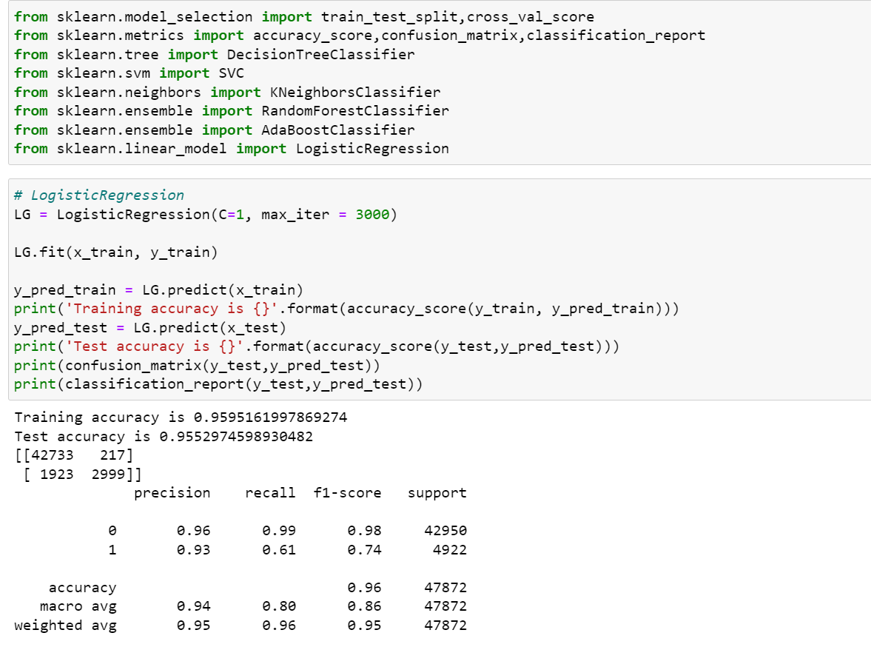
MODEL TRAINING

Slide 21
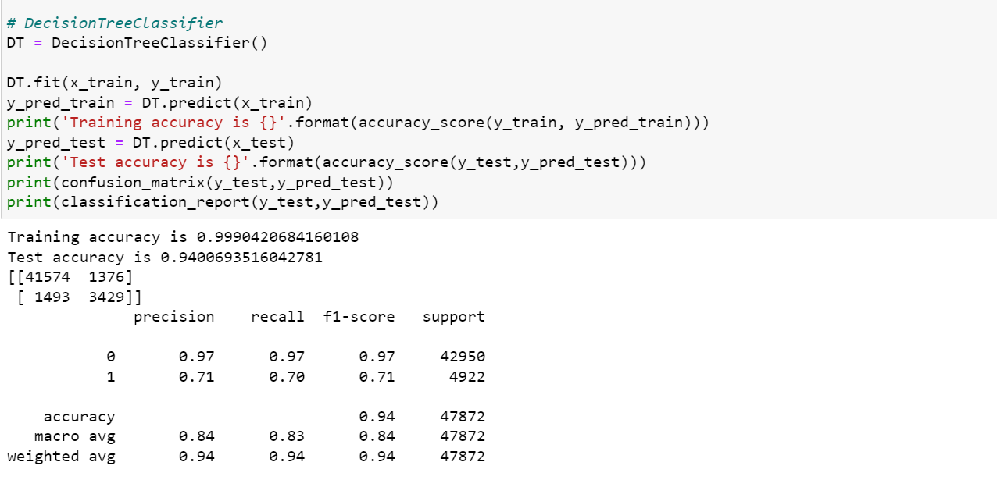
MODEL TRAINING

Slide 22
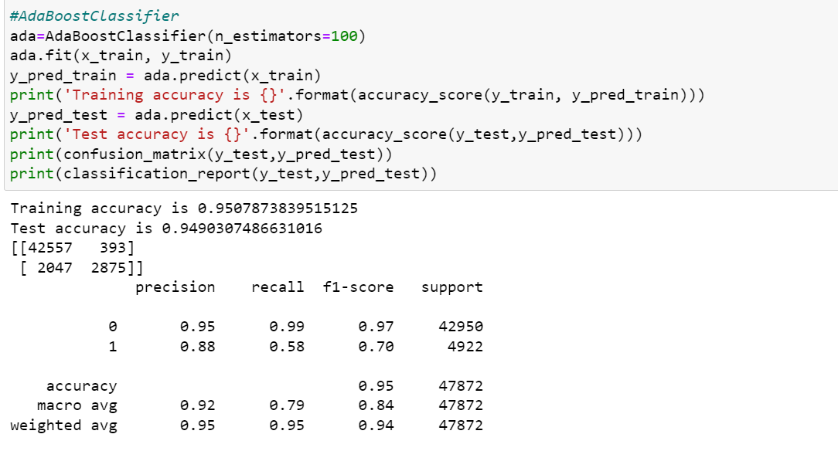
MODEL TRAINING

Slide 23
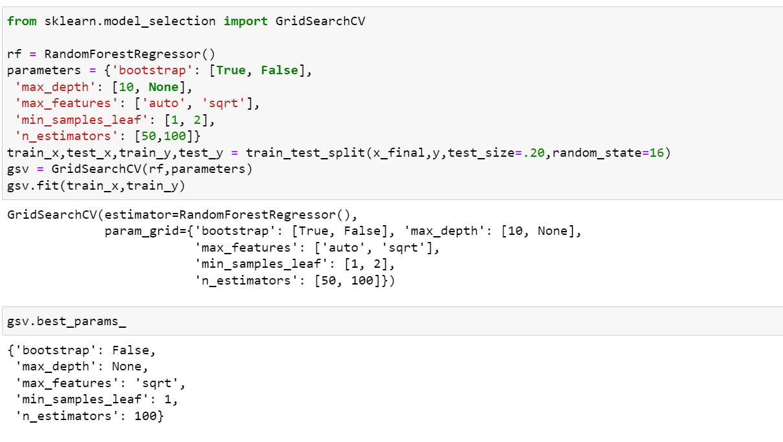
HYPERPARAMETER TUNING

Slide 24
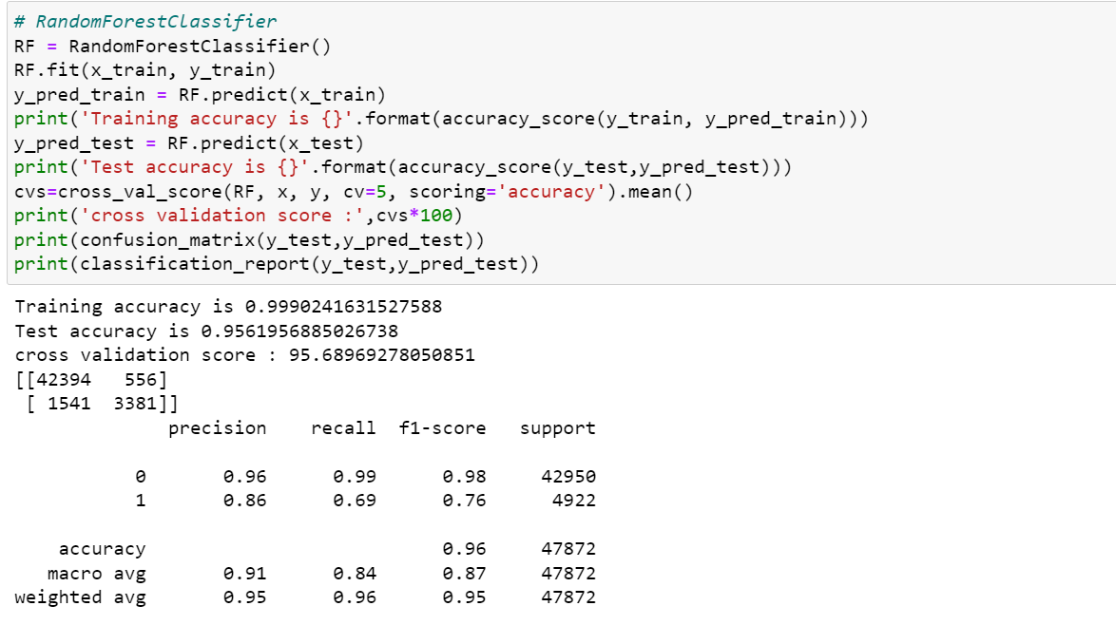
HYPERPARAMETER TUNING

Slide 25
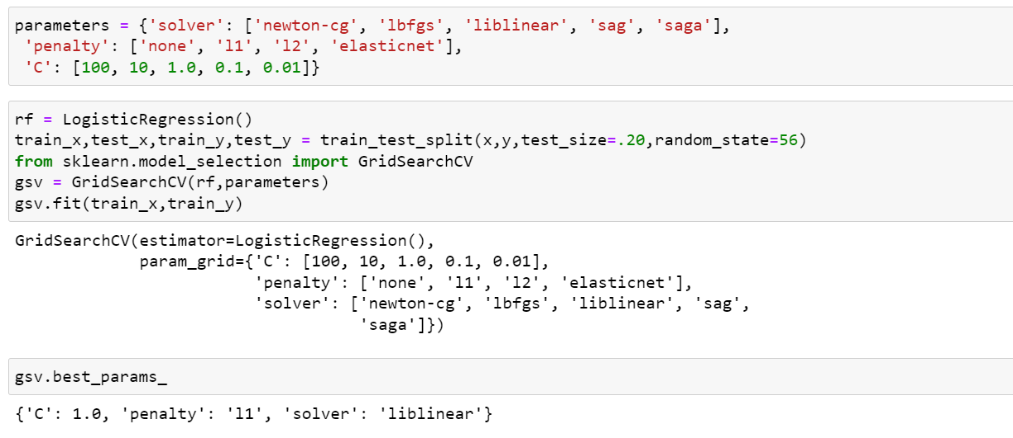
HYPERPARAMETER TUNING

Slide 26
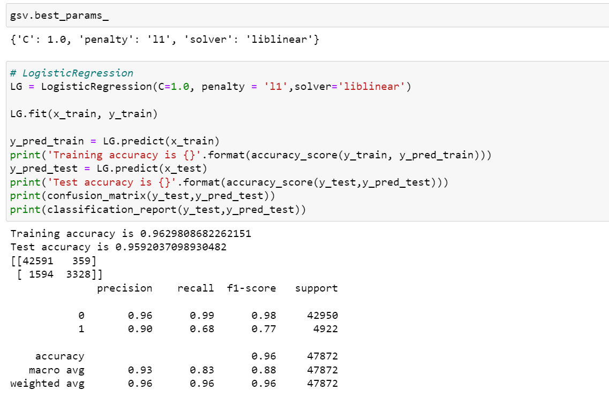
HYPERPARAMETER TUNING

Slide 27
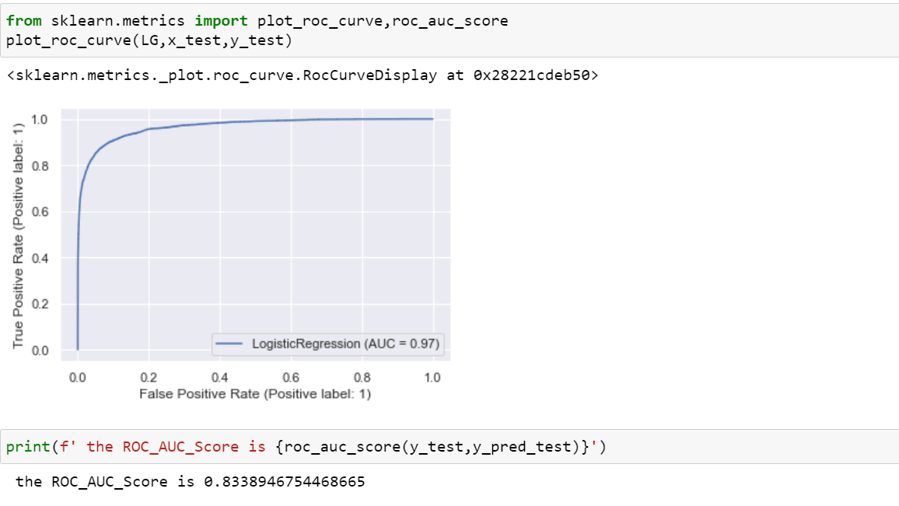
HYPERPARAMETER TUNING

Slide 28
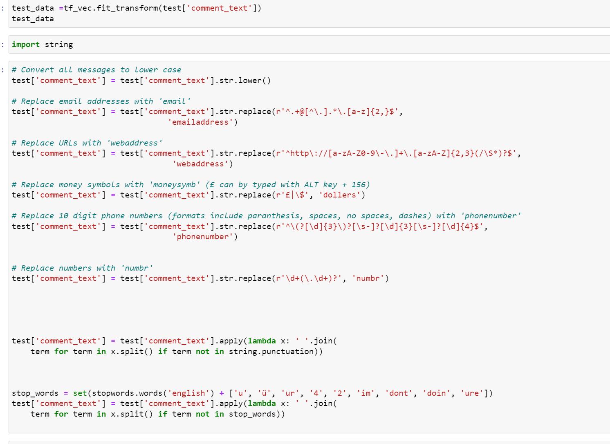

Slide 29
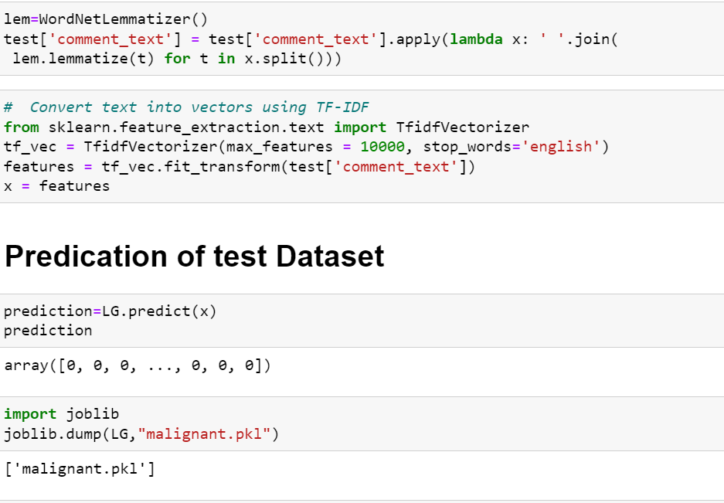

Slide 30
CONCLUSION
Key Findings and Conclusions of the Study
We can clearly see that Certain words affect the Comments Classification of the NLP Program.
Learning Outcomes of the Study in respect of Data Science
We can learn many useful insights from this study. the words people most often use to as threat rude etc. So based on these words NLP process the Comments classification.

Slide 31
THANK YOU FOR THE OPPORTUNITY :

